Slide 1
Microsoft Power Pages
Enterprise-grade low-code website development

Slide 2

Agenda
Introduction
What are Power Pages?
Why Power Pages?
What can you do with Power Pages
Power Pages Portals and Dynamics 365 portal
Create and Manage Power Pages
Power Pages portals Studio
Power Pages and visual studio code
Create and manage webpages
Portal Management app
Power Pages admin center
Demo

Slide 3

Why Power Pages

Slide 4
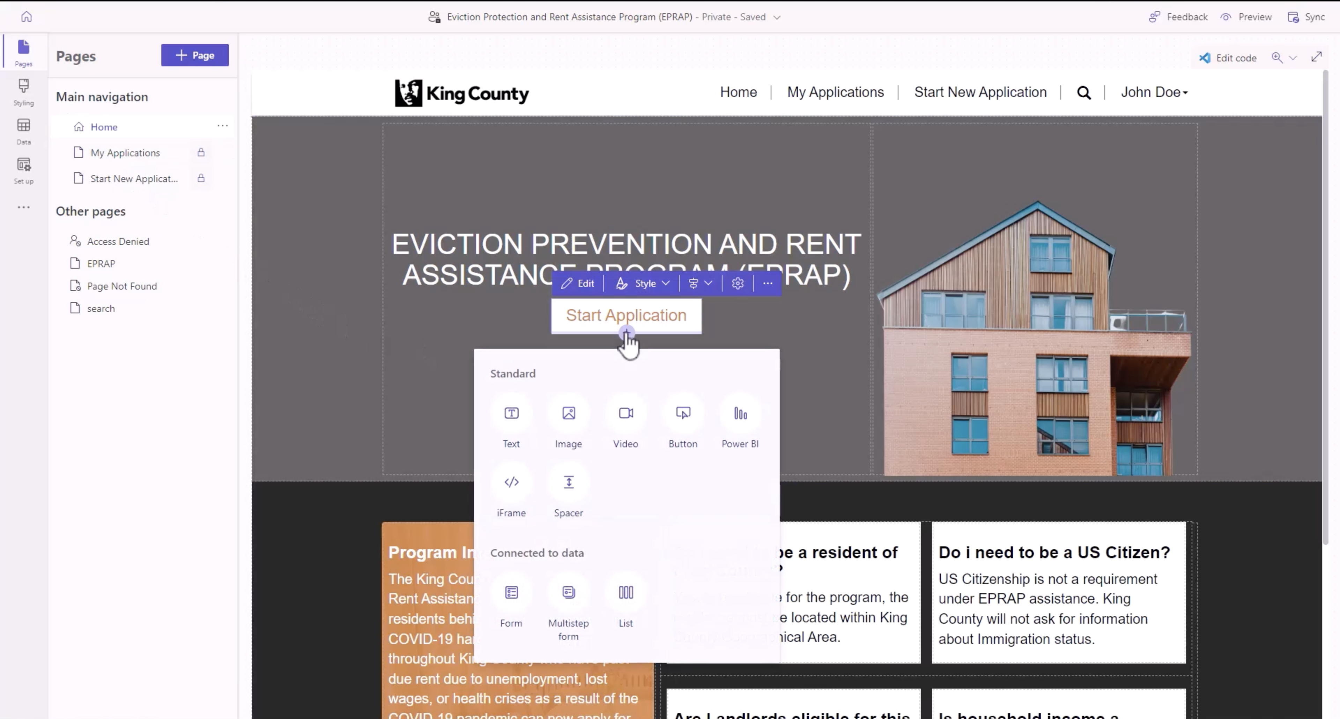
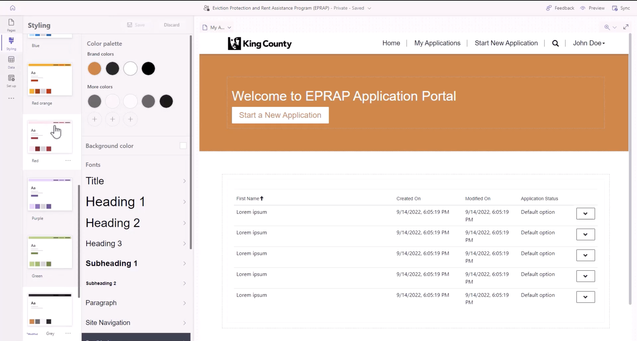
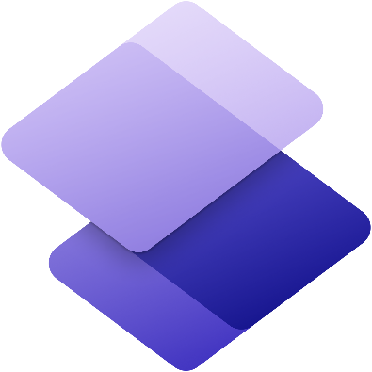
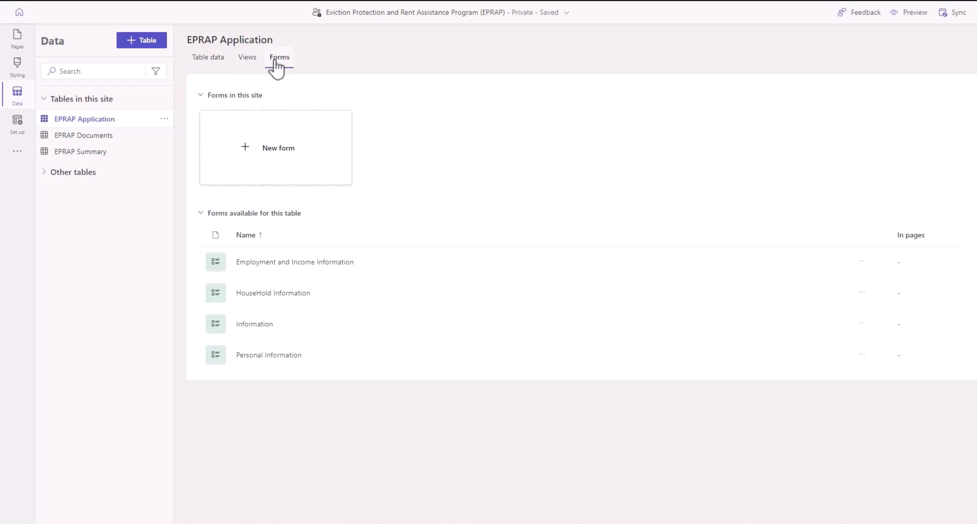
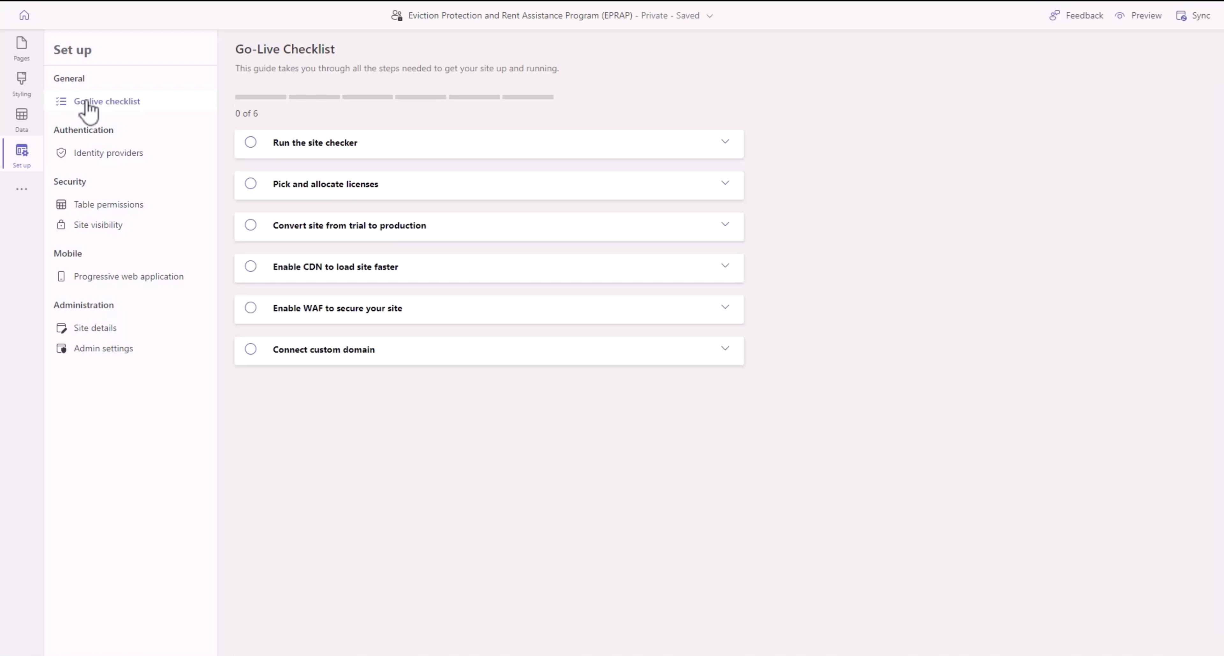
Reimagined Design Studio
Pages workspace
Styling workspace
Data workspace
Setup workspace

Slide 5
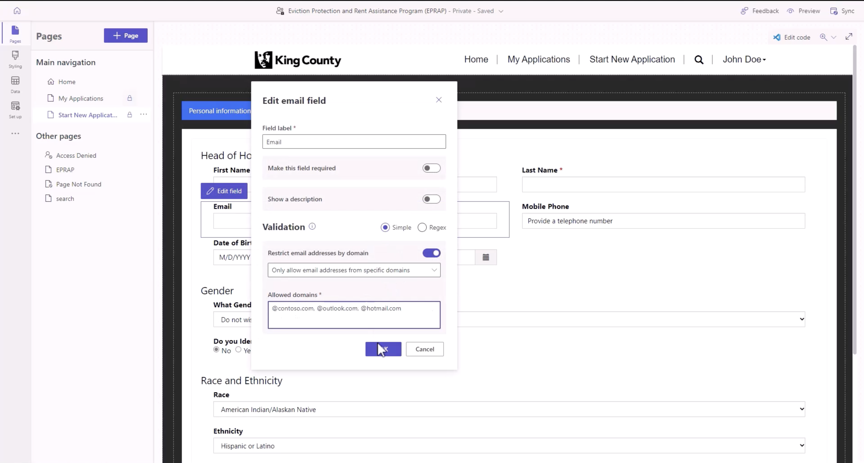
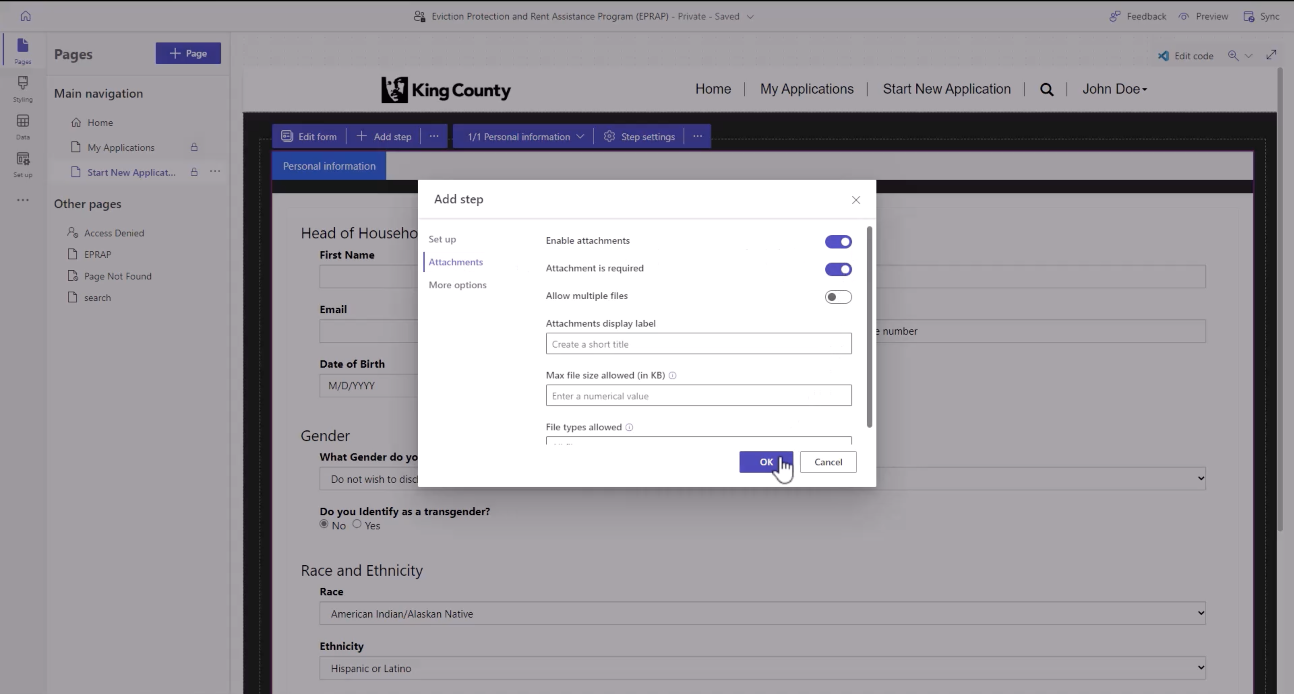
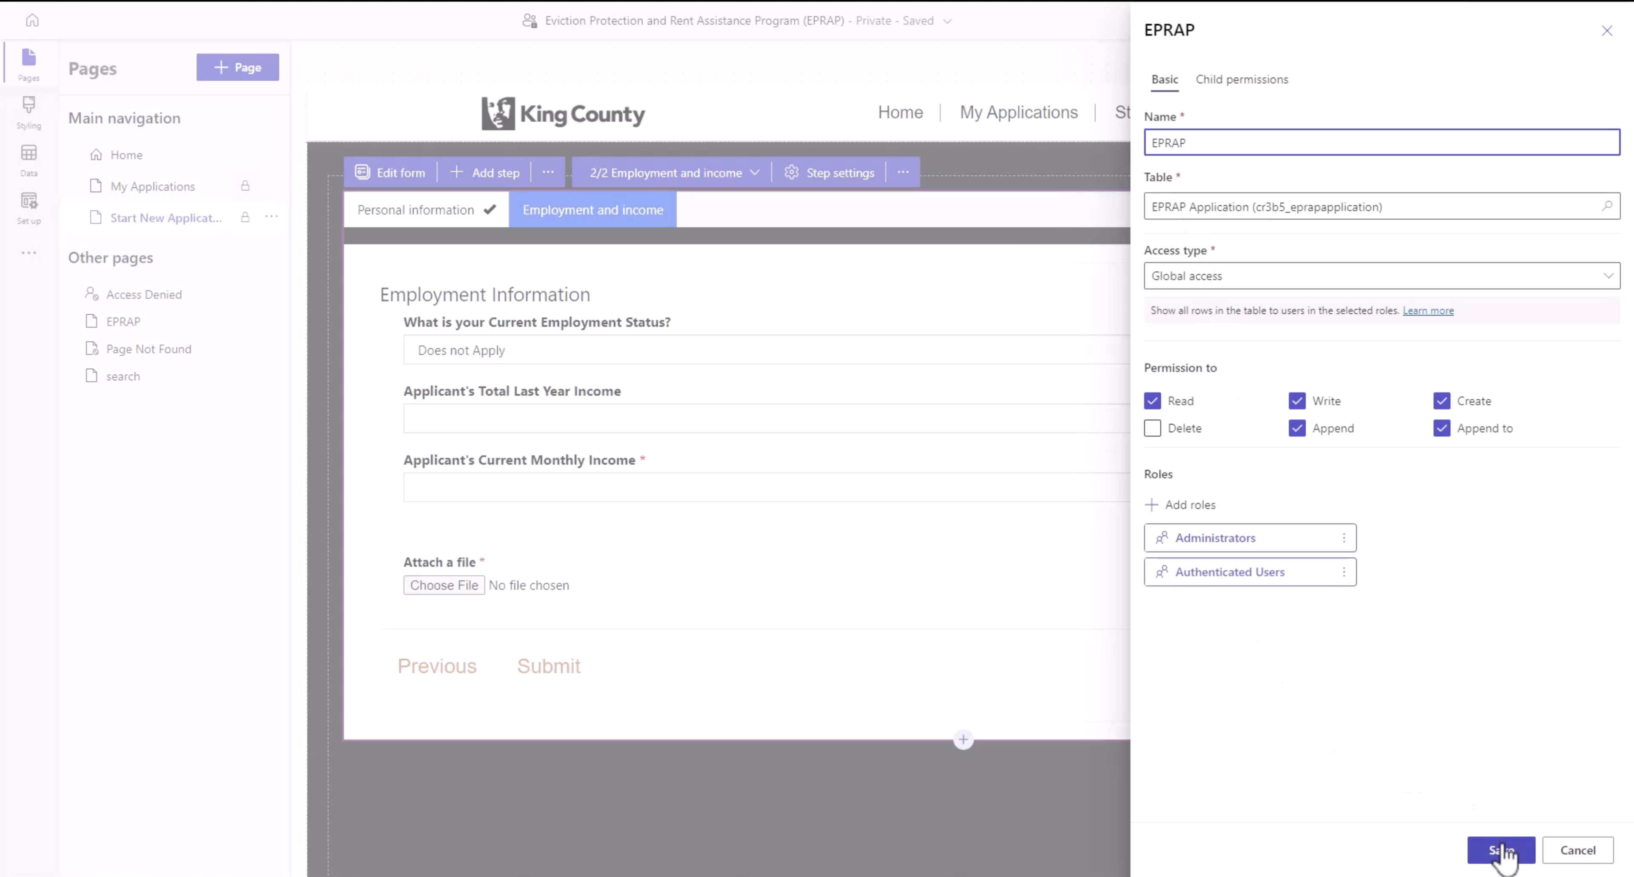
Low-code Multi-step form enablement
Seamless and intuitive form building and attachments without a line of code

Slide 6



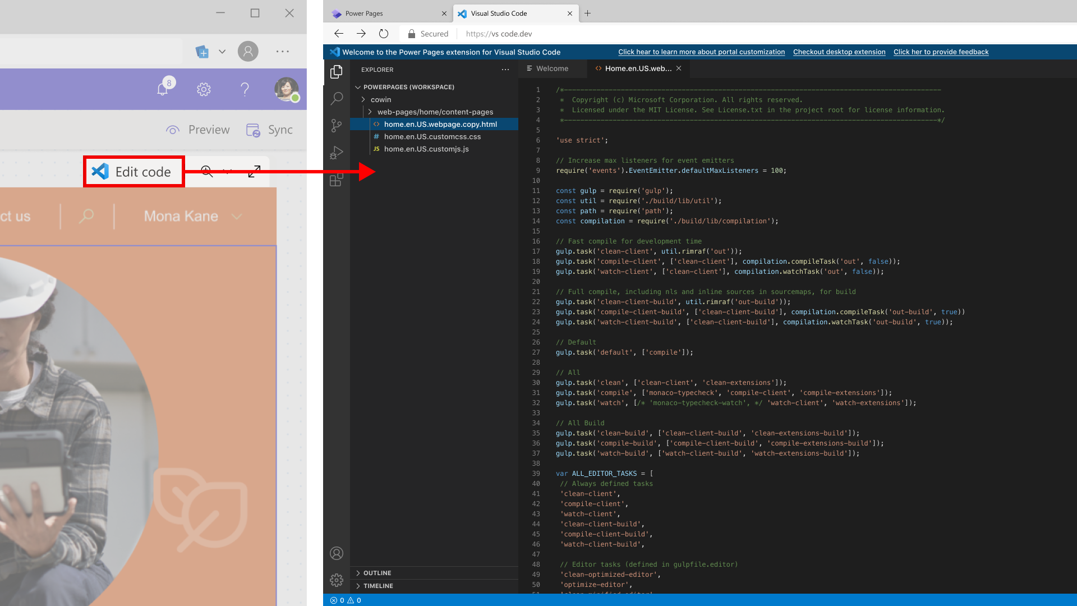
Best-in-class Pro-dev tooling
VS Code Web
VS Code
Github
Azure Dev Ops

Slide 7
Digital Transformation requires Engaging with your customers
An important part of success of a Digital Transformation is to involve experiences of end-users outside your organization, whether those are customers, partners, dealers or citizens
Ability of those audiences to self-service and enrich the digital feedback loop with more data in real-time, anytime, from anywhere and any device - is key to holistic Digital Transformation vision.

Slide 8
What makes Power Pages compelling?
Digital first low-code experiences
Best in class pro-dev tooling to extend and customize
The most secure & reliable enterprise-grade website hosting platform
Enables end-to-end innovation as a part of Power Platform

Slide 9

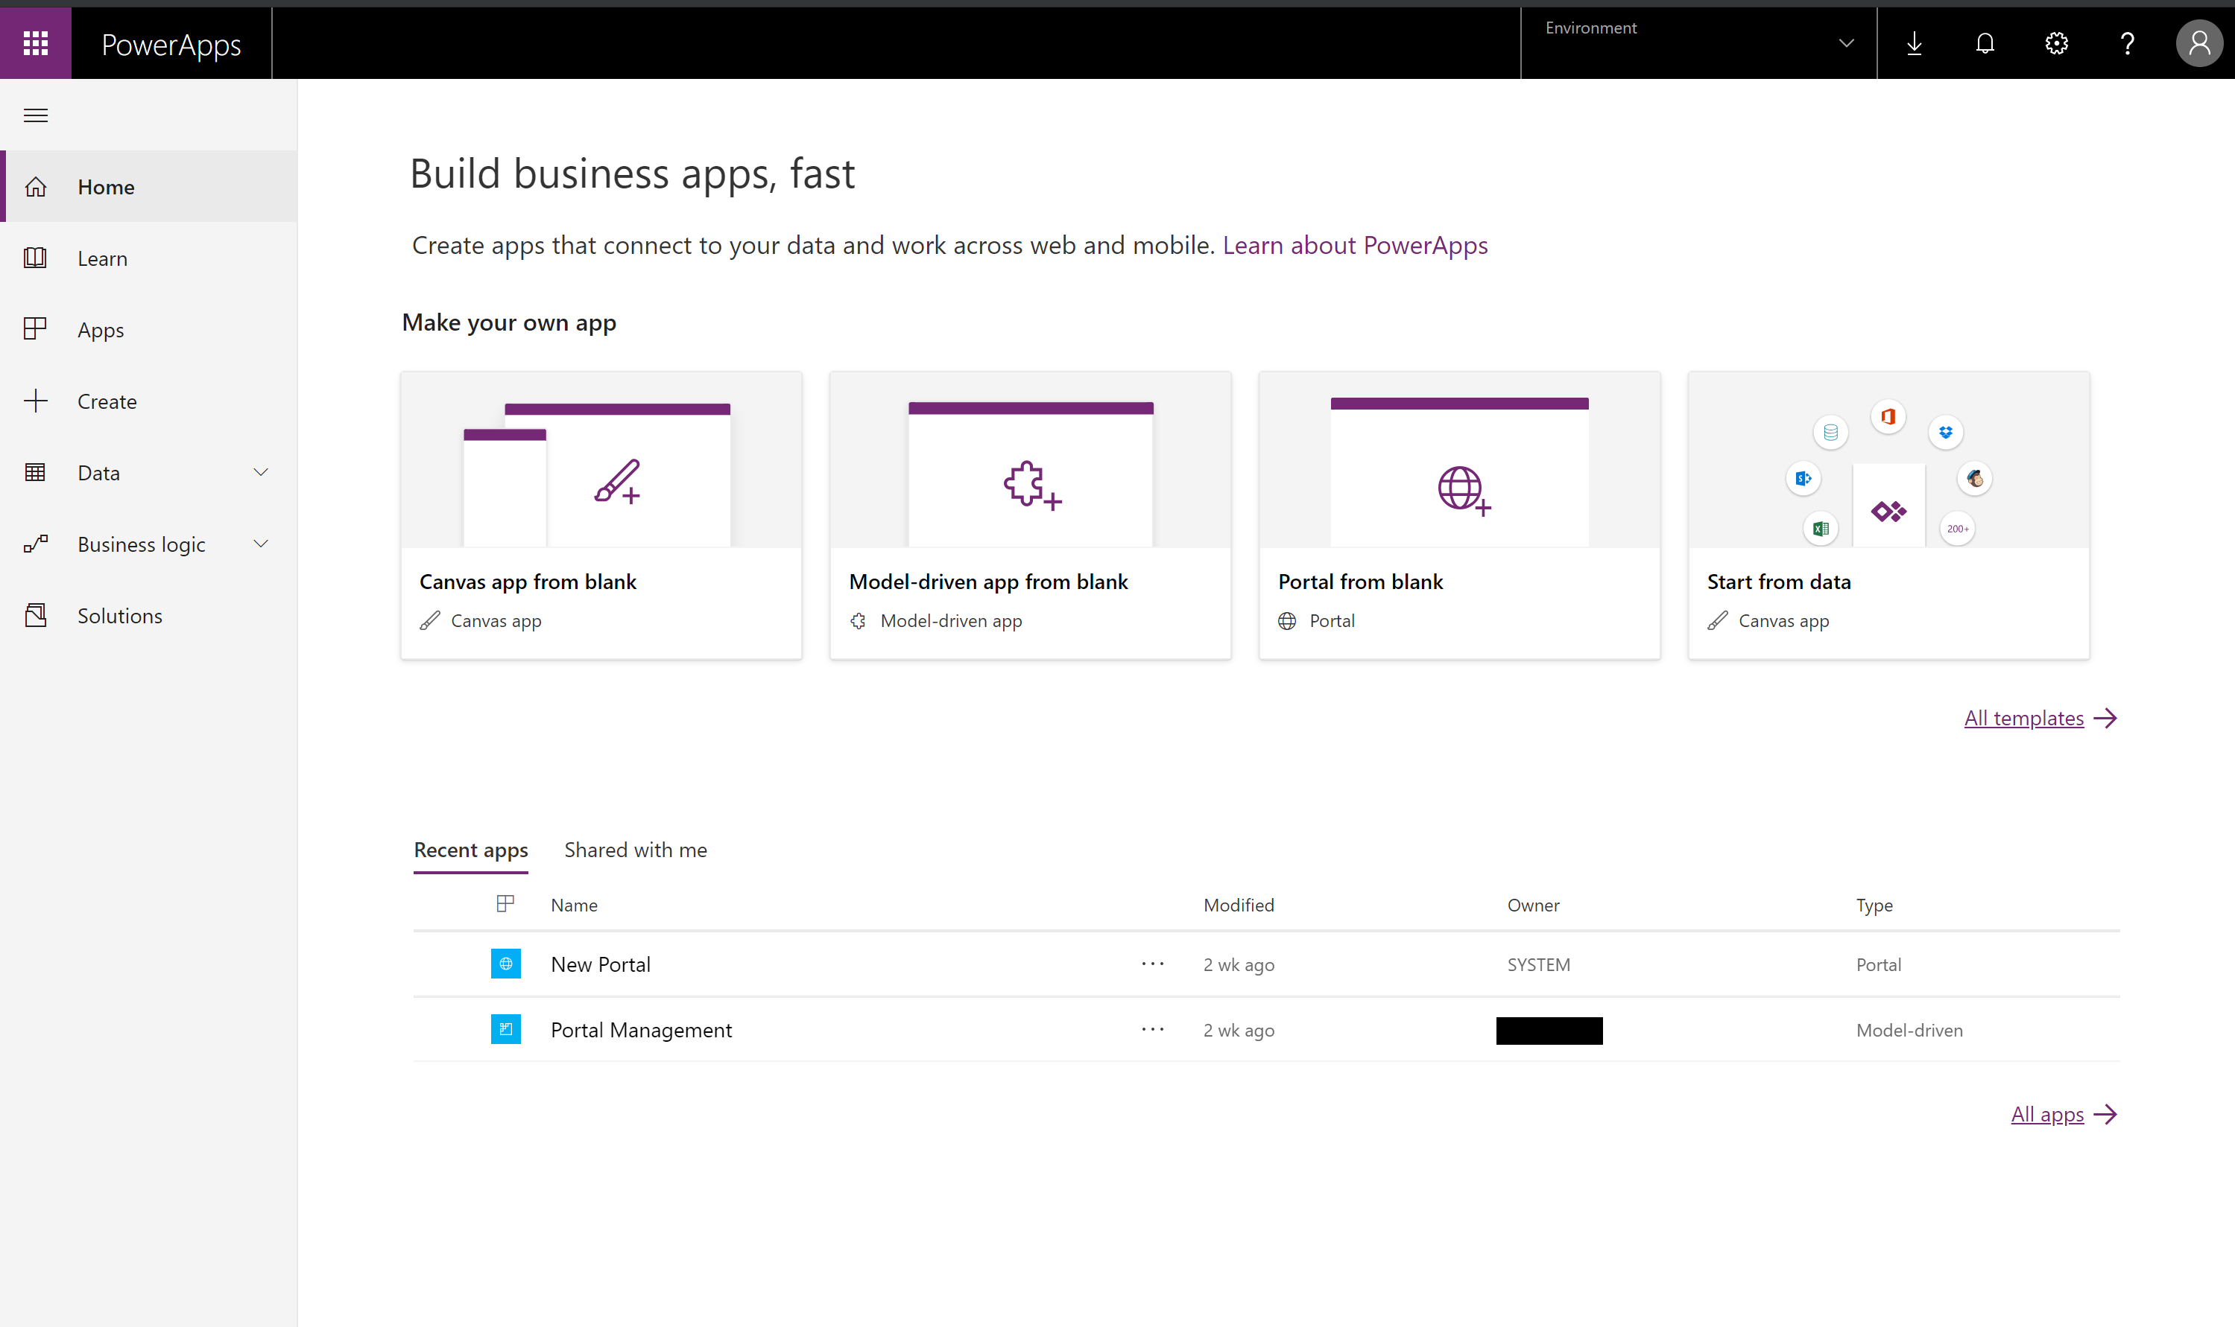
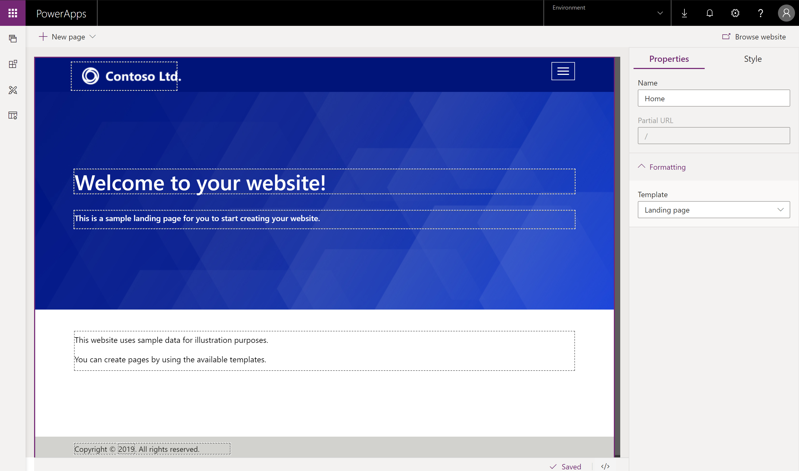

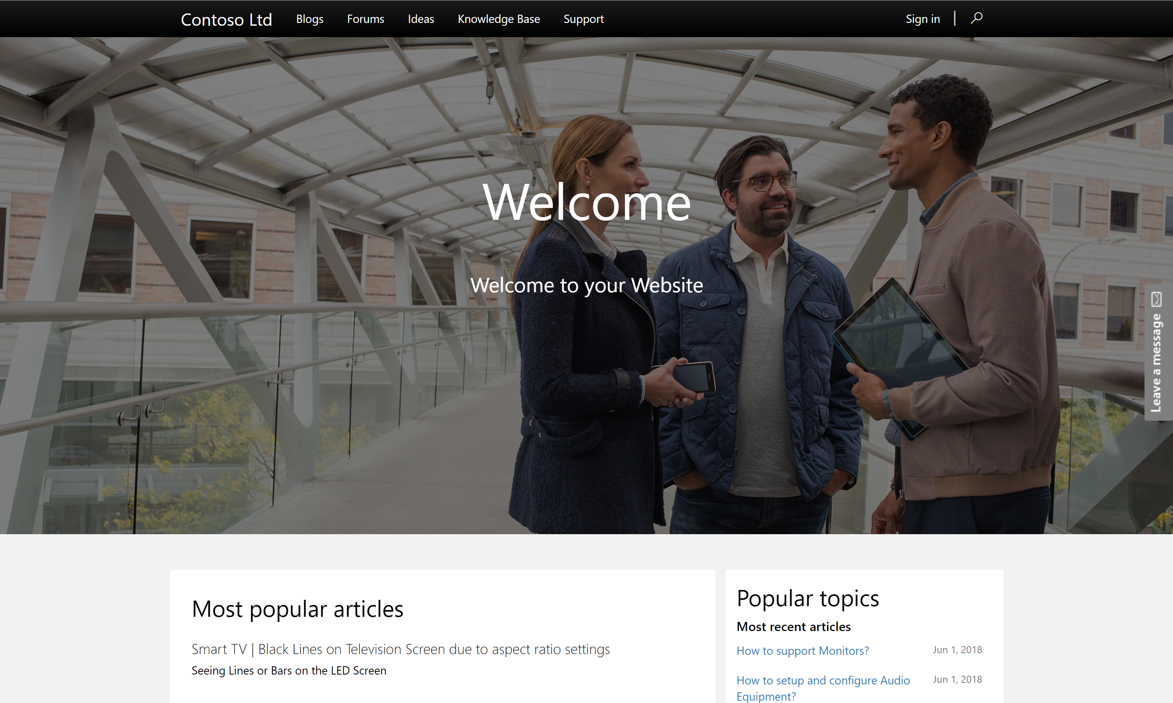
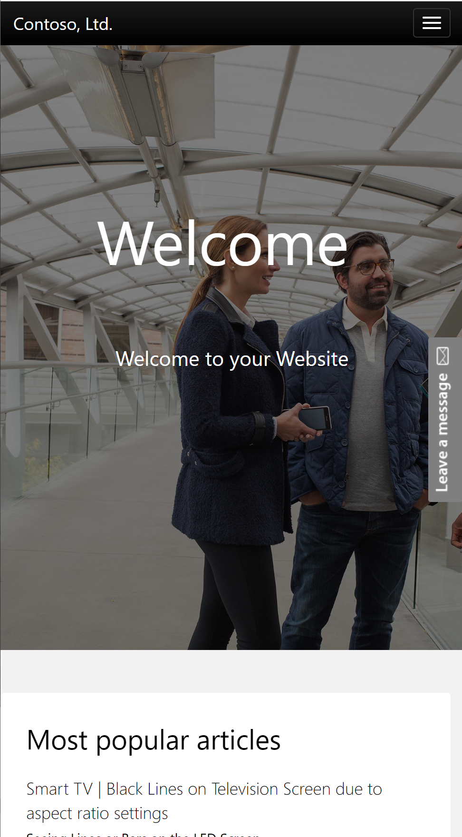

Power Pages:: Engage with your customers
Low code solution for creating multilingual, responsive websites for users external to your organizations as well as internal employees.
Use any of the commercial or enterprise login providers like Microsoft Account, LinkedIn, Azure AD B2C etc or even allow anonymous access.
Use WYSIWYG designer to create website content and enrich with CDS/Dynamics data using familiar constructs like forms, views, charts, dashboards.
Pro dev extensibility and templating capabilities to design complex business processes.
Use prebuilt templates like Customer Self Service, Partner Management, Event Management, Community Self Service or create your own portal.

Slide 10

What can you do with Power Pages

Slide 11
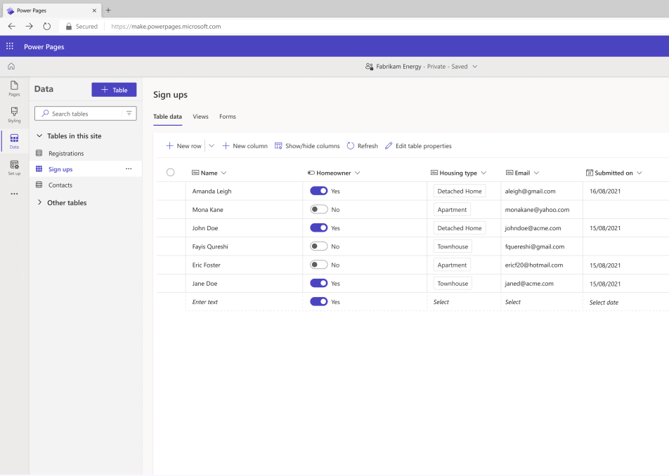
Model and visualize data
Capture and store business data in Dataverse tables, then model it with a simple-to-use table designer.

Slide 12
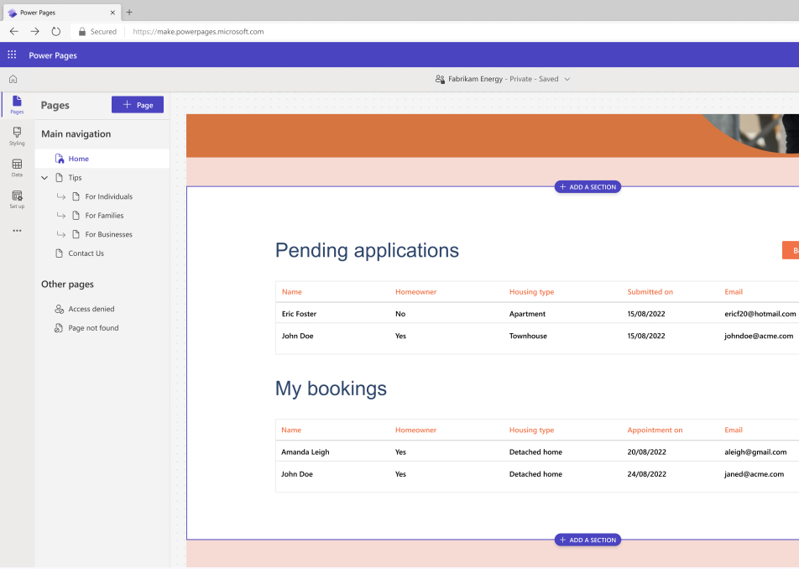
Make data lists
Create sortable, searchable tabular displays of business data for your site.

Slide 13
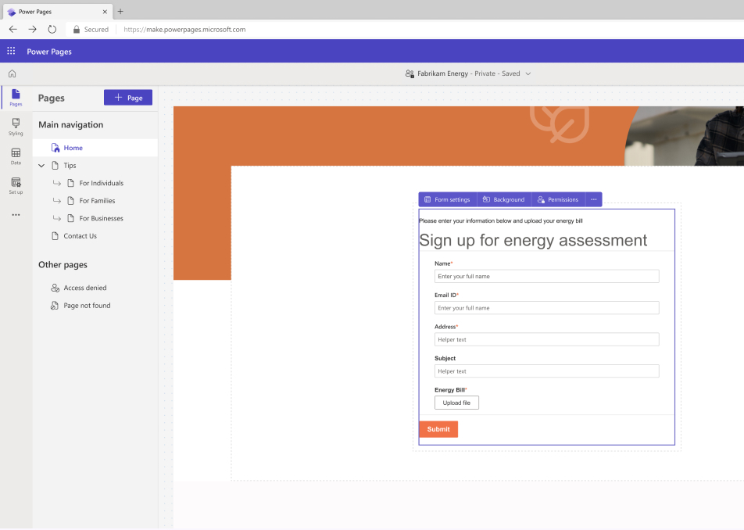
Collect data
Quickly design forms to collect data on site visitors – and use the insights to optimize your page.

Slide 14
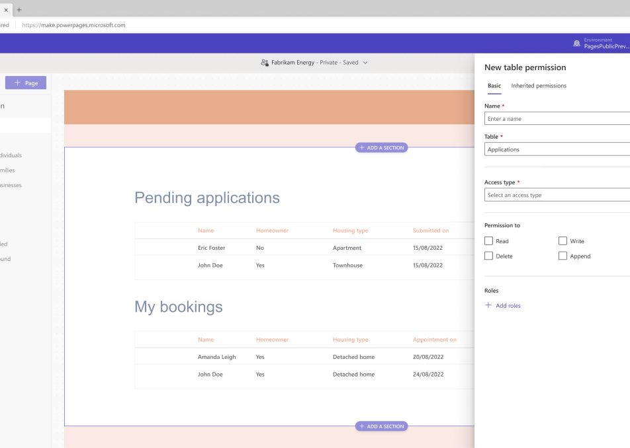
Set role-based permissions
Control the use of your business data by making it available only to visitors with assigned role-based access.

Slide 15
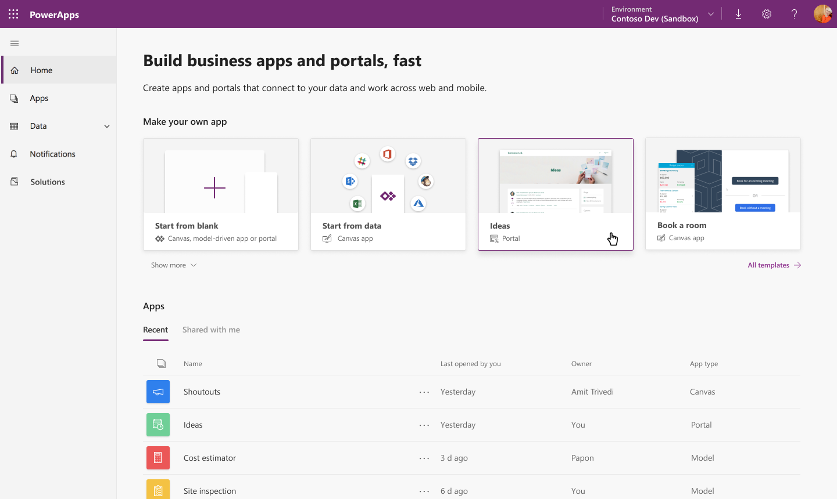
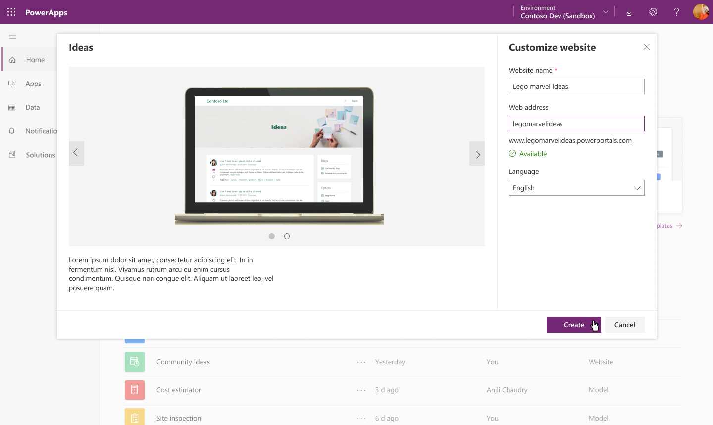
Quick and easy setup experience
Configure a new App type called “portal” from PowerApps home
Create a portal for CDS or Dynamics database
Use a prebuilt Dynamics application template like customer self service, partner management, event management etc or create your own portal.

Slide 16
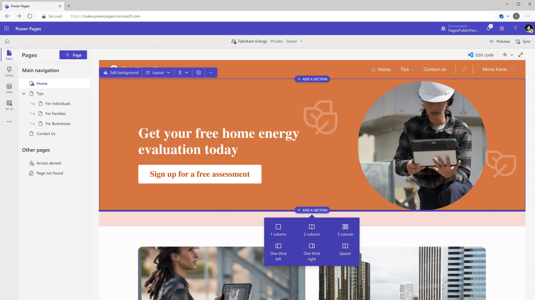
Easy to use Power Pages Design Studio Experience
Easily build with ready-to-use templates or create customizable experiences. Design your pages with text, video, imagery, and business data forms and lists
Simplified Power Pages to customize content of your website.
Create and manage pages in few clicks increasing your productivity multifold
Select predefined layouts or create your own templates (web templates)

Slide 17
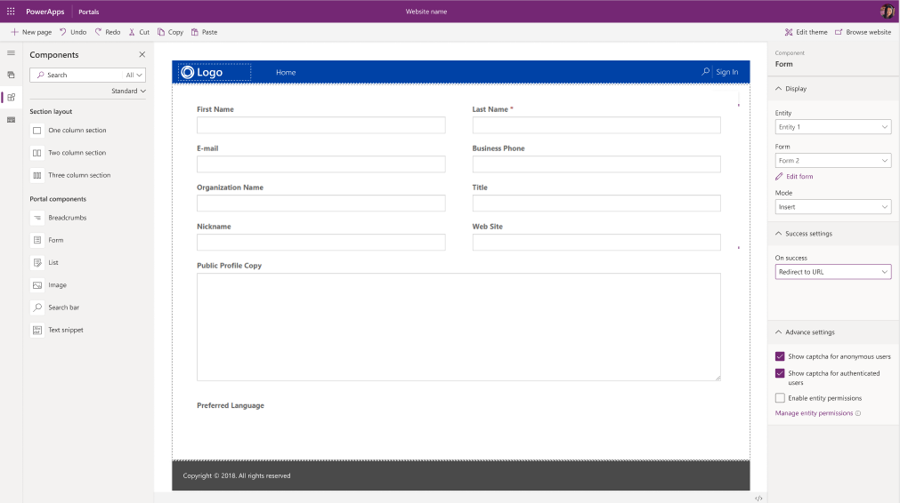
Expose your CDS/Dynamics data in few clicks!
Reuse Model driven app constructs like forms, views, charts, dashboards etc. to surface CDS data
One click integration with Form and View designers to help you update/create new forms/views.
Advanced form/view capabilities like CAPTCHA, geolocation, custom actions, workflow actions etc

Slide 18
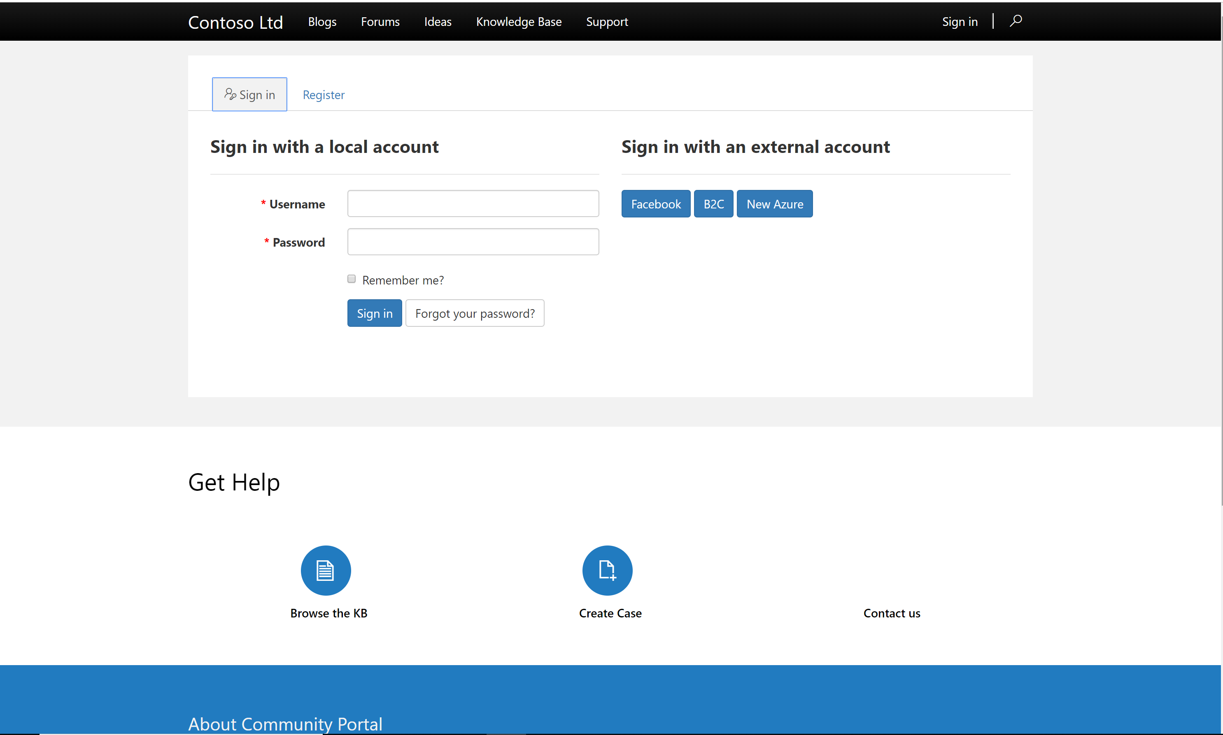
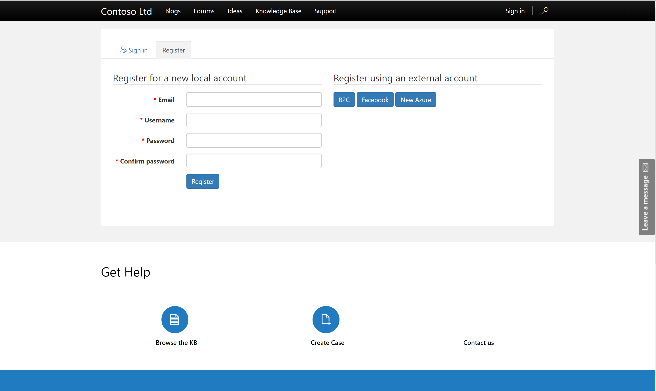
Extend to multiple audiences
Create Portals for users outside your organizations as well as internal employees.
Enable a variety of commercial login providers like Microsoft Account, LinkedIn, Facebook as well as enterprise Identity Providers like Azure AD B2C, Okta, Auth0 etc.
Enable Self Service Registration for end users or extend it to select users.
Enable Anonymous access for select content.

Slide 19
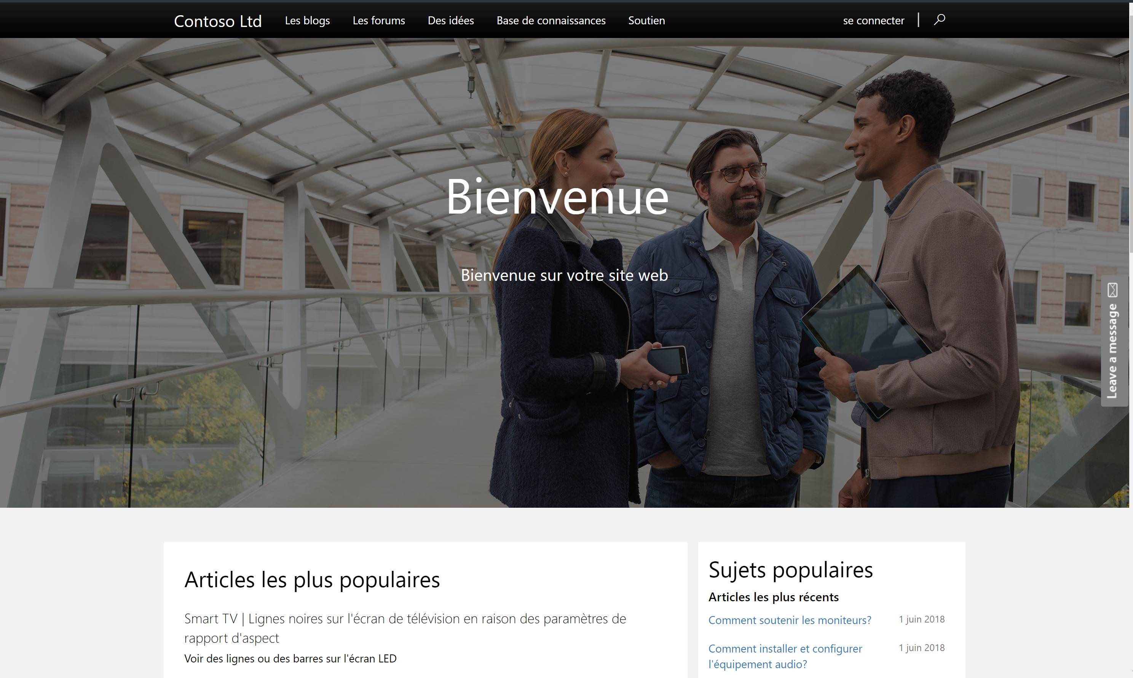
Create Pixel perfect, responsive and multilingual sites
Create pixel perfect websites using your own css or inline styles.
Use bootstrap themes to create responsive sites which work on every surface
Supports 43 base CDS languages (everything except RTL).
Supports language variations (like English(UK), French(Canadian) etc)
Fully accessible controls conforming to various standards.

Slide 20
Securely store and manage your data
Collect business data from site visitors with Microsoft Dataverse and share with external audiences.

Slide 21
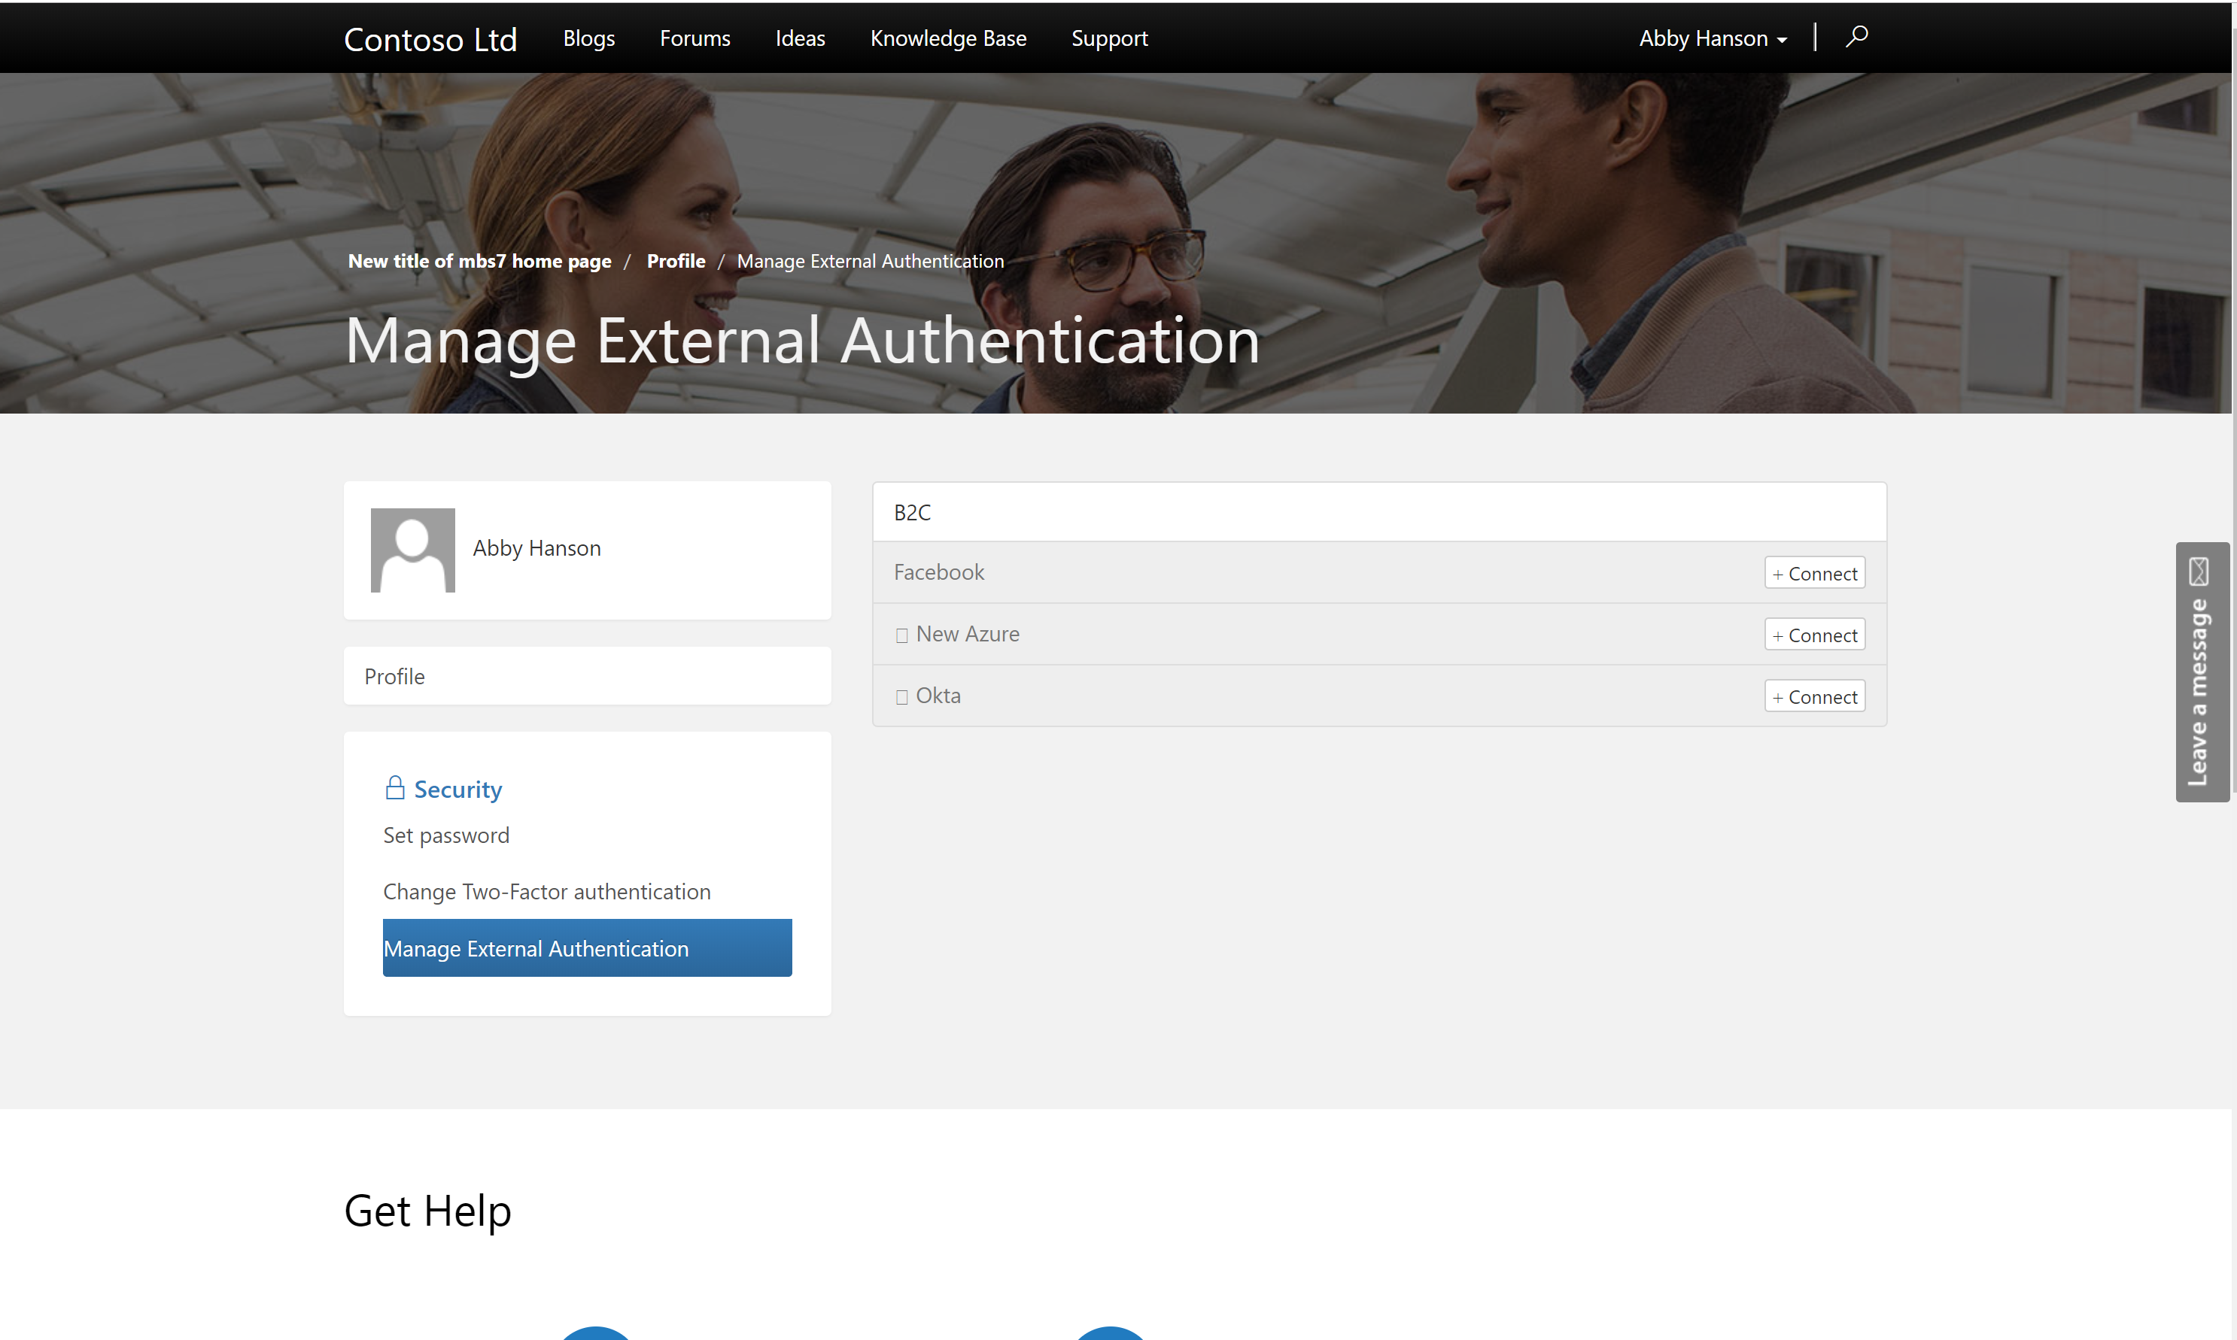
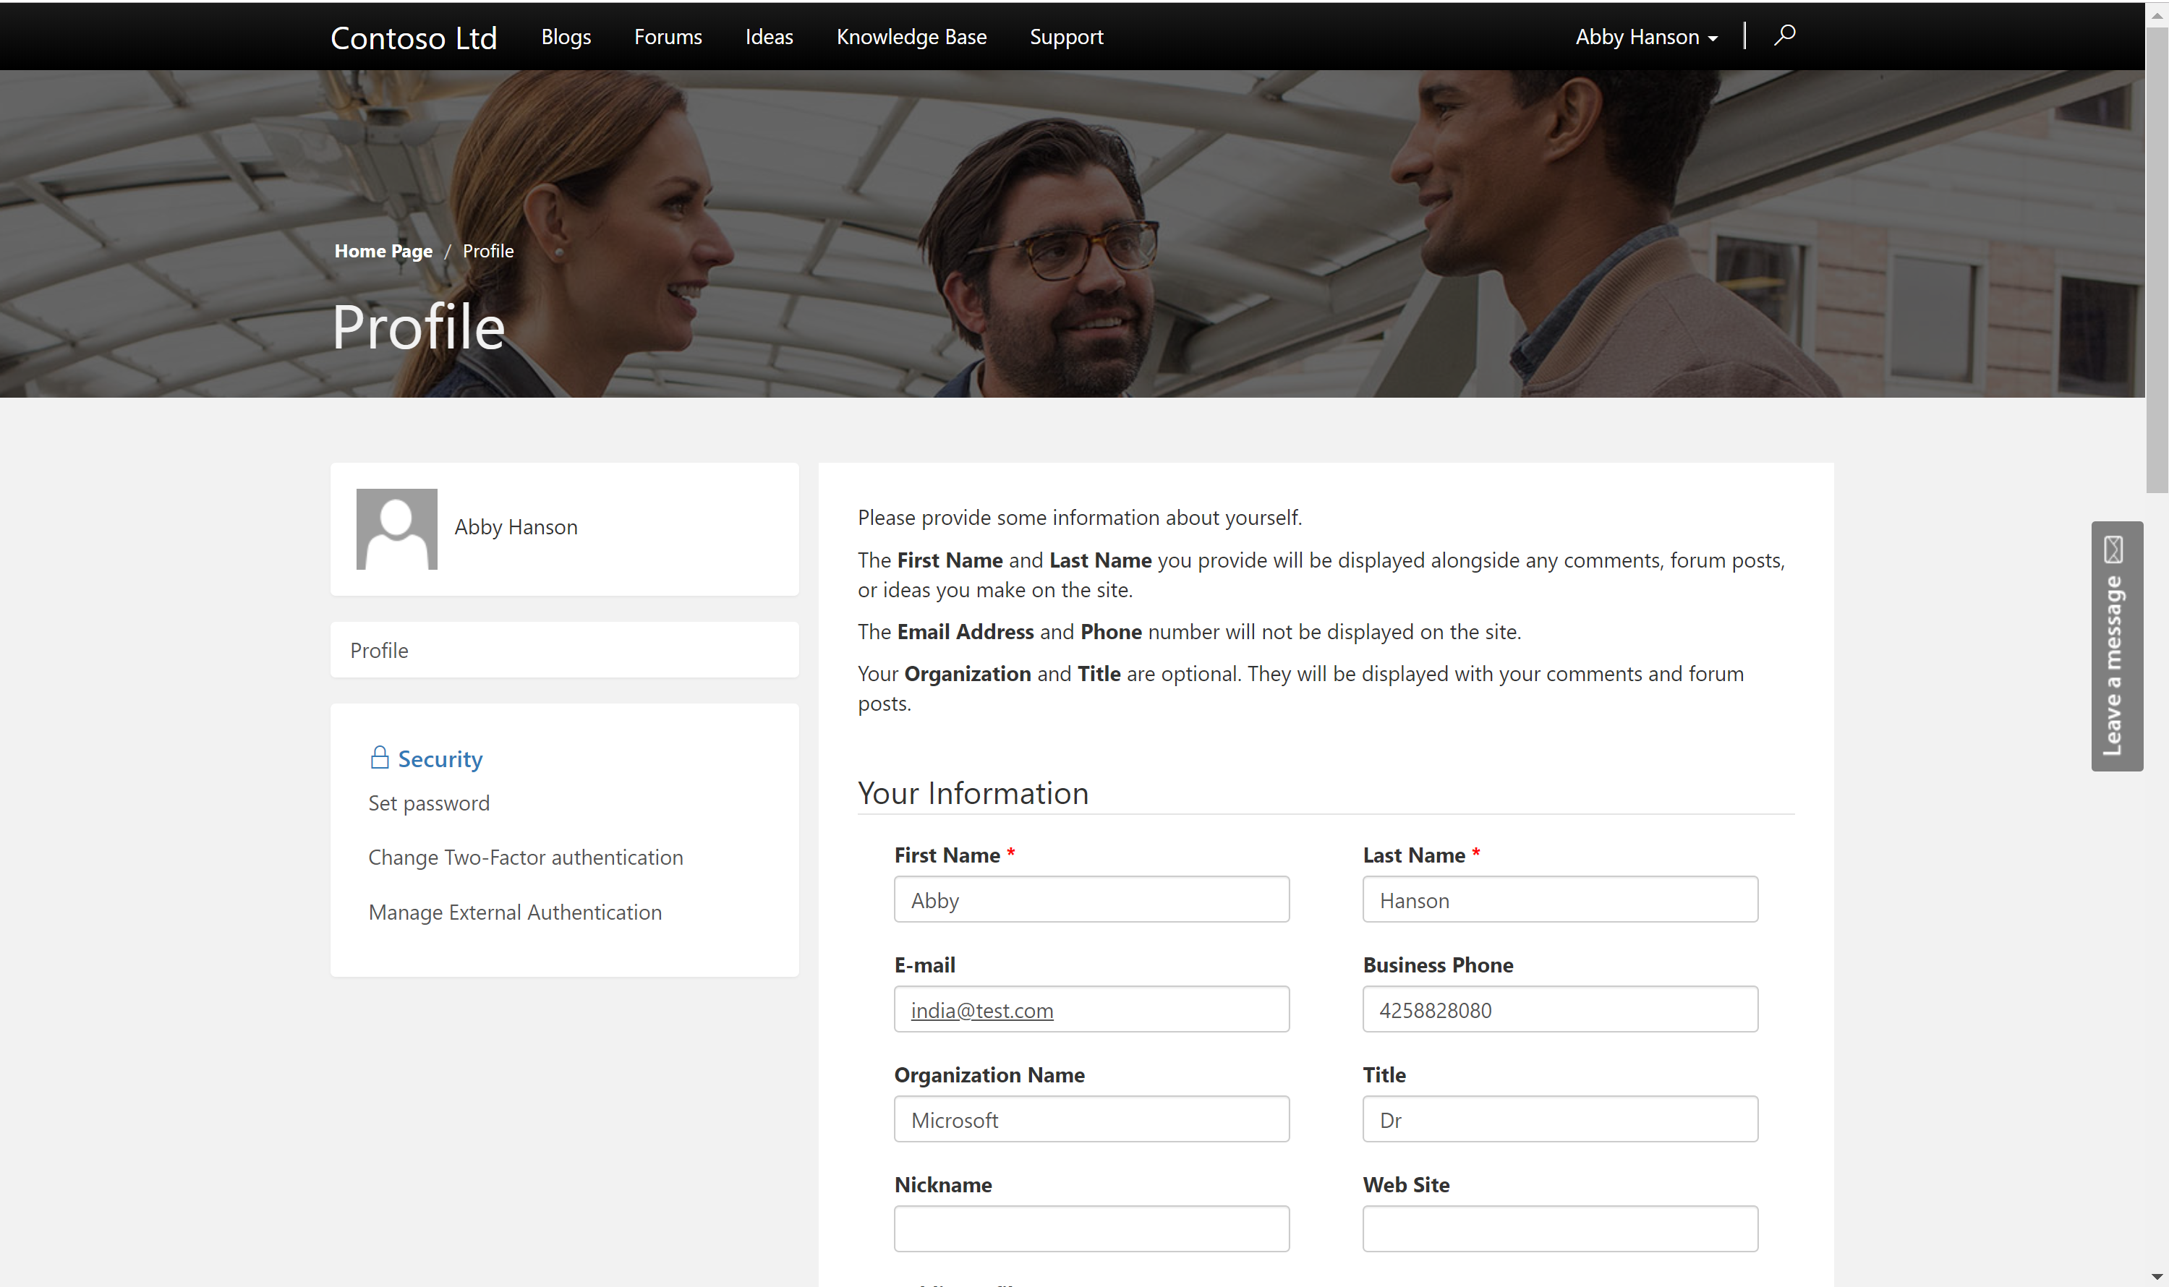
Profile Management and Security Model
All Portal users are modelled as contacts in CDS database.
Contact/Account based security model optimized for B2C as well as B2B interactions.
Self Service Profile Management right within the portal.
Allow users to link identities from multiple identity providers.

Slide 22
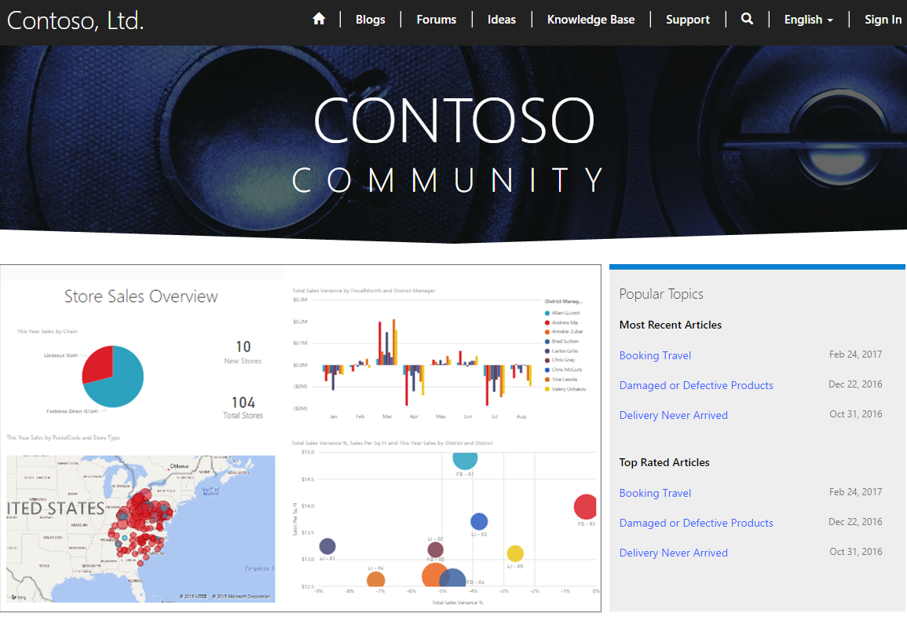
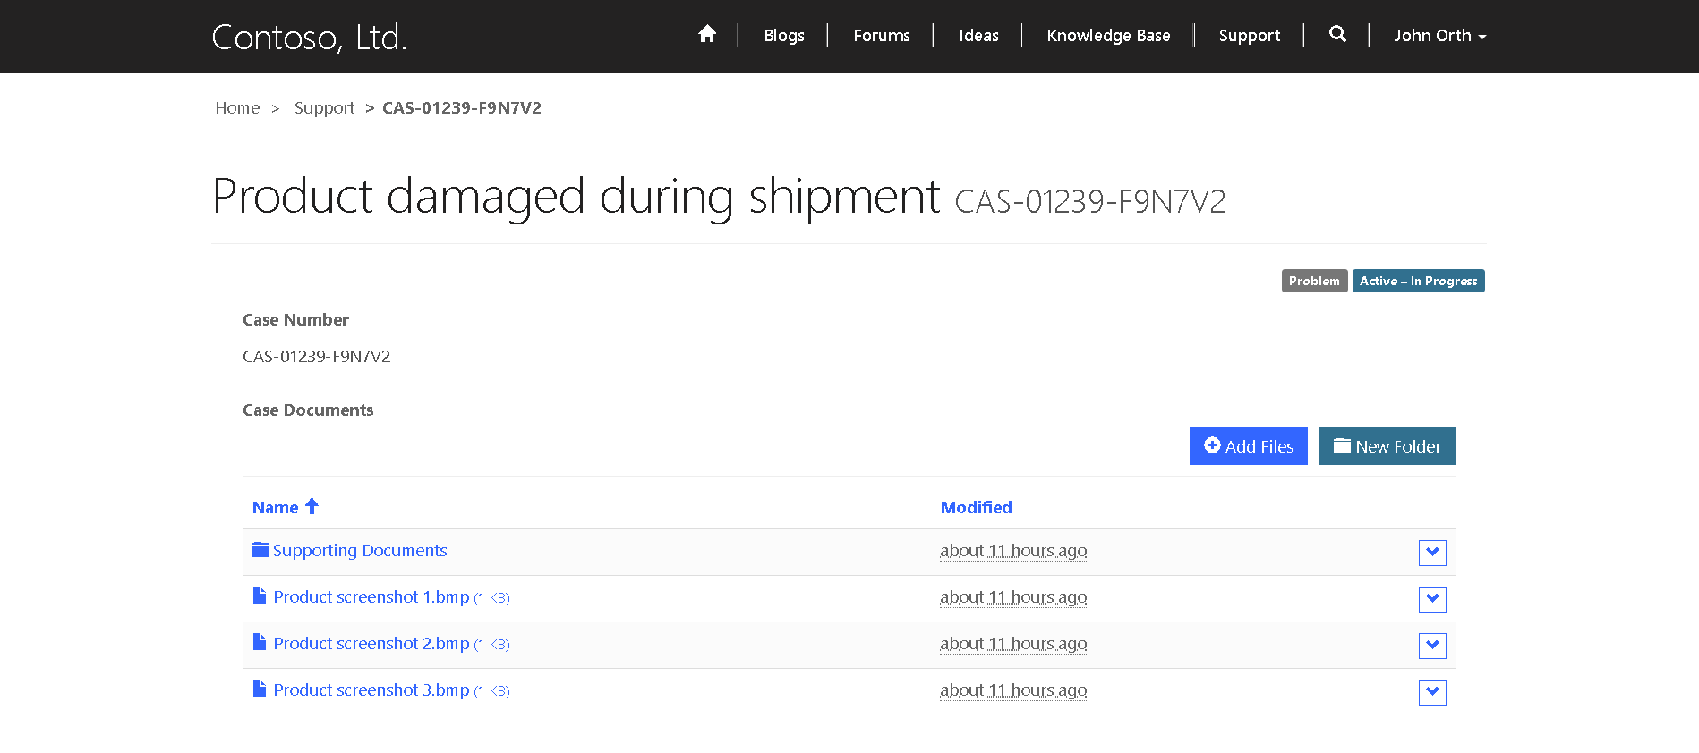
Integrate with other Microsoft Services
Integrate Power BI embed components like reports, dashboards and tiles.
Integrate SharePoint, Azure Blob storage as document storage.
Integrate with Azure AD B2C as Identity provider
Integrate with Azure Application Insights for usage telemetry, Azure Application Gateway for providing additional security

Slide 23
Pro dev Extensibility and Governance
Ability to access CDS data and enable personalization using liquid templating language.
Ability to create reusable web templates for defining page layouts as well as web services.
Use CDS server-side constructs like code plugins, workflows as well as Microsoft flow to extend business logic.
Advanced admin options like IP address filtering, server-side logs, Portal Checker and many more

Slide 24

Power Pages and Dynamics 365 portal

Slide 25
Power Pages == Dynamics 365 portals ++
PowerApps Portals is the platform on which Dynamics 365 portals works. PowerApps Portals brings following key capabilities: -
Extends Portals beyond Dynamics 365 Applications and allows you to create a portal on Common Data Service.
Provides a simplified low code/no-code designer experience to create Portals.
All the capabilities of Dynamics 365 portals will be available and will work as it is.

Slide 26
What happens to Dynamics 365 portals
All Dynamics 365 portals will get automatically converted into PowerApps portal during GA.
All the new capabilities of PowerApps portal (Designer, management experience) would be available automatically to Dynamics 365 portal customers.
Branding of all experiences will be changed to PowerApps Portals.

Slide 27
Hands-on

Slide 28
Hands-on
Portal Creation
Create the Dataverse database tables
Create Portal App
Basic Form
Advanced Form
Style using CSS
Manage Authentication and Authorization

